Slide 1
Lecture 4
16th Nov 2022
News sharing and discussion
Dr. MRIDULA MISHRA

Slide 2
Unit 2
Talent Management : talent management, talent retention, talent acquisition and sources of talent acquisition
Recruitment and Selection : recruitment and selection process, recruitment and selection methods
Dr. MRIDULA MISHRA

Slide 3
Learning Outcomes
Students will be able to learn and understand
Recruitment and Selection : recruitment and selection process, recruitment and selection methods
Dr. MRIDULA MISHRA

Slide 4
MCQs
_____ is the procedures through which one determines the duties associated with positions and the characteristics of people to hire for those positions.
  Job description
  Job specification
  Job analysis
  Job context
Notes:
c

Slide 5
MCQs
Which of the following types of information can be collected via a job analysis?
  work activities
  human behaviors
  job context
  all of the above
Notes:
d

Slide 6
HUMAN RESOURCE
PLANNING
DETERMINE RECRUITMENT
and
SELECTION
JOB ANALYSIS
Notes:
https://builtin.com/recruiting/recruitment-strategies

Slide 7
Recruitment
The process of finding and attracting capable applicants for employment.
The process begins when new recruits are required and ends when their applications are submitted.
The result is a pool of applicants from which new employees are selected.
Recruitment is a process of inviting applications from prospective employees.
Recruitment is a positive process.

Slide 8
Purposes and Importance
Determine the present and future requirements of the organization
Increase the pool of the at minimum cost
Identify under qualified and over qualified applicants
Reduced the probability of recruited and selected applicants will leave the organization only after a short period of time

Slide 9
Meet the organization’s legal and social obligations
Identifying the appropriate candidates
Increase organizational and individuals efficiency in the short term and long term
Evaluate the effectiveness of various recruiting techniques and sources for all types of job applicants

Slide 10
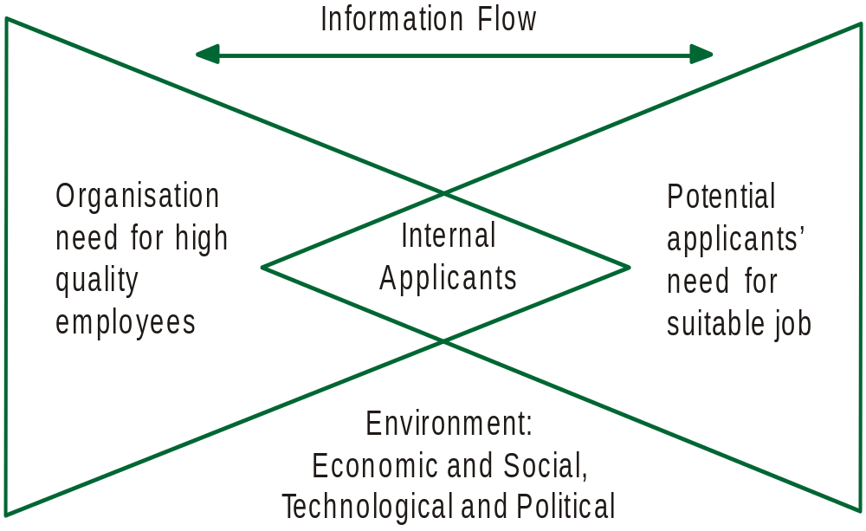
Recruitment: Matching the Needs of Applications and Organizations'

Slide 11
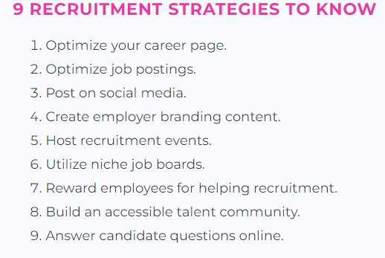
Dr. MRIDULA MISHRA
Notes:
https://builtin.com/recruiting/recruitment-strategies

Slide 12
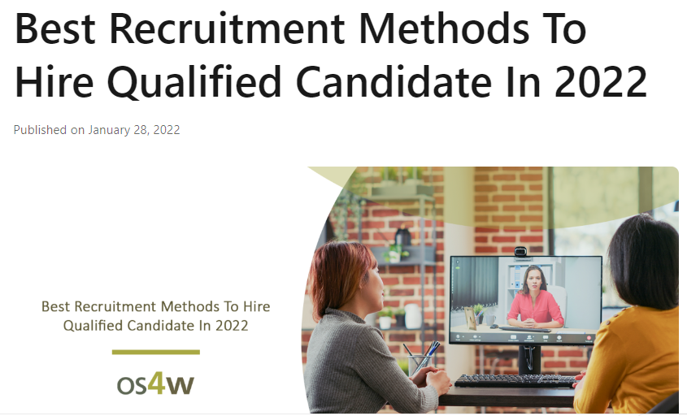
Dr. MRIDULA MISHRA
Notes:
https://www.linkedin.com/pulse/best-recruitment-methods-hire-qualified-candidate-/

Slide 13
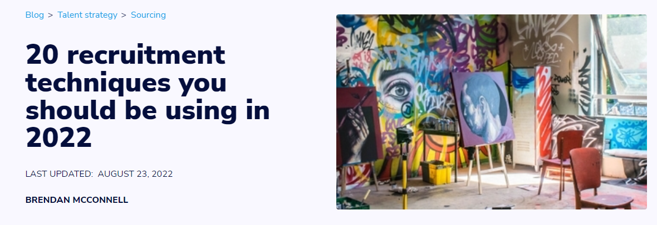
Dr. MRIDULA MISHRA

Slide 14
Sources of Recruitment
External source
Placement services
Advertisements
Employment
Exchange
Campus Recruitment
Walk-ins
Consultants
Contractors
Displaced Persons
Radio and television
Acquisition and
Mergers
Competitors
E-recruitment
INTERNAL SOURCES
Present Employees
Employee Referrals
Former Employees
Previous Applicants
Recruitment

Slide 15
Factors Affecting
EXTERNAL FORCES
Supply and demand
Unemployment rate
Labor market
Political-social
Image
RECRUITMENT
Internal Forces
Recruitment policy
HRP
Size of the firm
Cost
Growth and
expansion

Slide 16
Recruitment Process
Personal
planning
Job
Analysis
Employment
demand
SELECTION
Searching
Activation
‘Advertising’
Message
Media
Recruitment
Planning
Numbers
Types
Job
Vacancy
Applicant
pool
Screening
Potential
hires
Strategy
Development
Where
How
When
Evaluation
and
control
Application
population

Slide 17
Recruitment Process
Recruiting Required Personnel
Search for Perspective Employees
External Sources
Internal Sources
Evaluating effectiveness of process

Slide 18
Recruitment Process
Personnel Requisition -: Requisition for recruitment from other department, Contains information like no of person required, duties to be performed, desired qualification, time of appointment, information about job.
Locating and developing sources of required no. and type of employees.

Slide 19
Process (contd.)
Identifying the potential employees with required characteristics.
Communicating the information about the organization, the job and the terms and condition of service.
Encouraging the identified candidates to apply for jobs in the organization.
Evaluating the effectiveness of recruitment process.

Slide 20
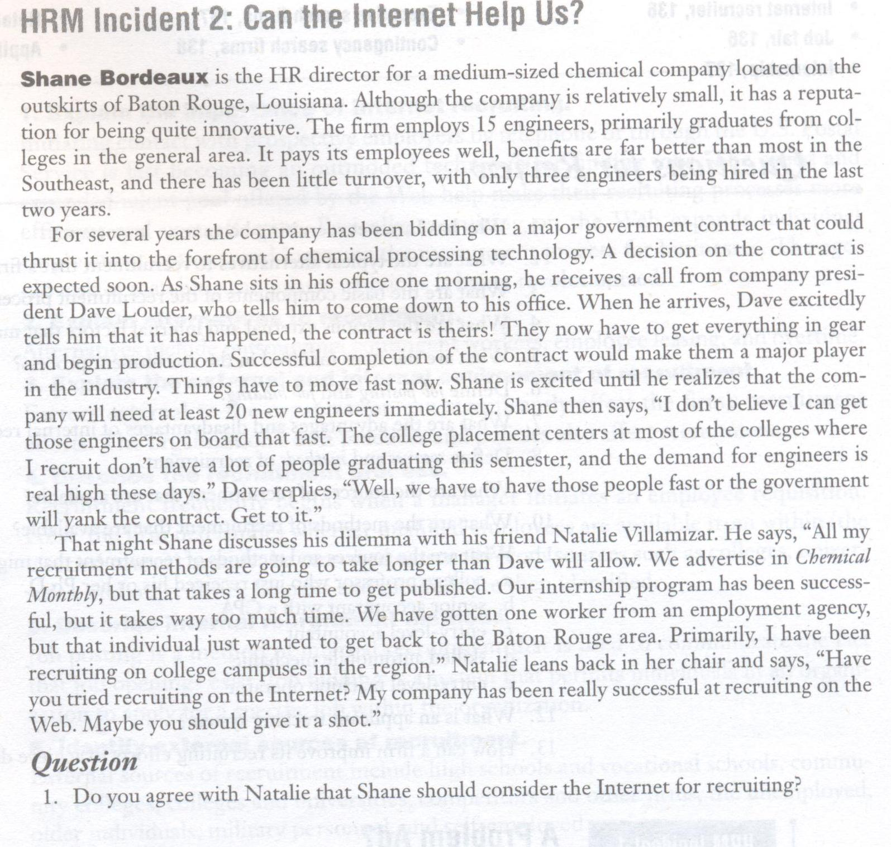

Slide 21
Selection: selection process, barriers to effective selection, selection challenges in India

Slide 22

SELECTION

Slide 23
INTRODUCTION
Selection is the process of picking individuals who have relevant qualifications to fill jobs in an organization.
It is an attempt to strike a happy balance between what the applicant can and wants to do and what the organization requires.
It is the process of differentiating between applicants in order to identify (and hire) those with a greater likelihood of success in a job

Slide 24
ESSENTIALS OF SELECTION
Picking individuals possessing relevant qualifications
Matching job requirements with the profile of candidates
Using multiple tools and techniques to find the most suitable candidates capable
Of achieving success on the job

Slide 25
Differences Between Recruitment and Selection
Recruitment refers to the process of identifying and encouraging prospective employees to apply for jobs.
Recruitment is said to be positive in its approach as it seeks to attract as many candidates as possible.
Selection is concerned with picking the right candidates from a pool of applicants.
Selection is negative in its application inasmuch as it seeks to eliminate as many unqualified applicants as possible in order to identify the right candidates.

Slide 26

The Process of Selection
Reception
Screening Interview
Application Blank
Selection Tests
Selection Interview
Medical Examination
Reference Checks
Hiring Decision
Selection is usually a series of hurdles or steps. Each one must be successfully cleared before the applicant proceeds to the next

Slide 27

The Process of Selection
Reception
A warm, friendly and courteous reception is extended to candidates with a view to create a favourable impression. Employment possibilities are also communicated honestly and clearly
Screening Interview
The HR department tries to screen out the obvious misfits through this courtesy interview. A prescribed application form is given to candidates who are found to be suitable.
Application Blank
It is a printed form completed by job aspirants detailing their educational background, previous work history and certain personal data.

Slide 28
Contents of Application Blank
Personal data (address, sex, identification marks)
Marital data (single or married, children, dependents)
Physical data (height, weight, health condition)
Educational data (levels of formal education, marks, distinctions)
Employment data (past experience, promotions, nature of duties, reasons for leaving previous jobs, salary drawn, etc.)
Extra-curricular activities data (sports/games, NSS, NCC, prizes won, leisure-time activities)
References (names of two or more people who certify the suitability of an applicant to the advertised position)

Slide 29
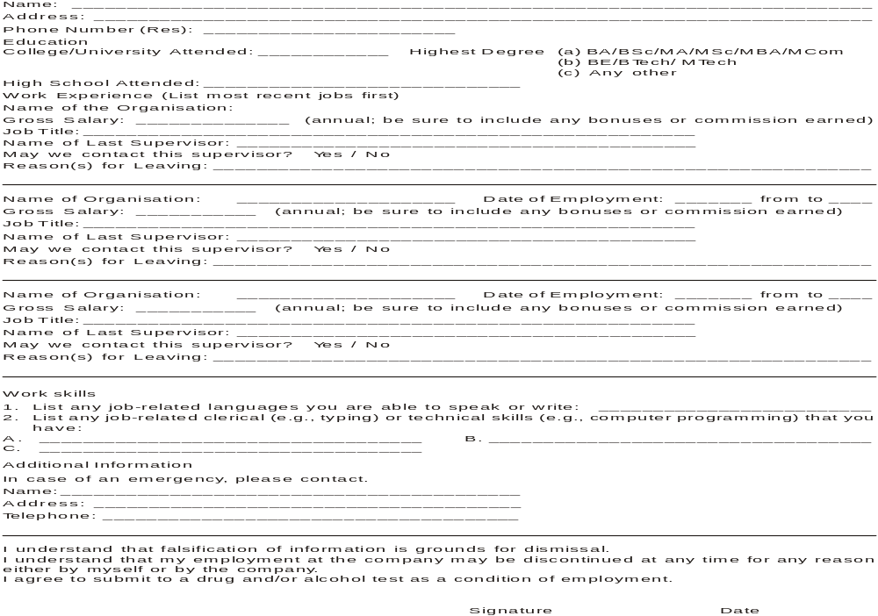
Sample Application Blank

Slide 30
The Process of Selection
Weighted Application Blank
The items that have a strong relationship to job performance are given numeric values or weights so that a company can cross-compare candidates with more or less similar qualifications on paper
Weighted Application Blank
It is a printed form completed by candidate wherein each item is weighted and scored based on its importance as a determinant of job success
It helps a company to cross-compare candidates having more or less similar qualifications and reject those not meeting the job criteria strictly
On the negative side, it is difficult to develop an appropriate WAB, the exercise could be quite costly, and it needs frequent updating so as to be in line with changing job requirements.

Slide 31
SELECTION TESTING
A test is a standardized, objective measure of a sample of behaviour. Selection tests are increasingly used by companies these days because they measure individual differences in a scientific way, leaving very little room for Individual bias.

Slide 32
Selection Tests
Intelligence test
Aptitude test
Personality test - Projective Test, Interest Test and Preference Test
Achievement test
Simulation test
Assessment centre
The in basket
The leaderless group discussion
Business games
Individual presentations
Graphology test - www.mysticscripts.com/personality-test/graphology/
Polygraph test - www.gotoquiz.com/online_lie_detector
Integrity test - http://www.employtest.com/integrity-test-for-work

Slide 33


Slide 34
SELECTION TESTING
A. Intelligence tests: They measure a candidate’s learning ability and also the ability to understand instructions and make judgements. They do not measure any single trait but several mental abilities (memory, vocabulary, fluency, numerical ability, perception etc)
B. Aptitude tests: They measure a candidate’s potential to learn clerical, mechanical and mathematical skills. Since they do not measure a candidate’s on the job motivation, they are generally administered in combination with other tests.
Personality tests: They measure basic aspects of a candidate’s personality such as motivation, emotional balance, self confidence, interpersonal behaviour, introversion etc.
  Projective tests: These tests expect the candidates to interpret problems or situations based on their own motives, attitudes, values etc (interpreting a picture, reacting to a situation etc)

Slide 35
SELECTION TESTING
  Interest tests: These are meant to find how a person in tests compares with the interests of successful people in a specific job. These tests show the areas of work in which a person is most interested.
  Preference tests: These tests try to compare employee preferences with the job and organisational requirements.
D. Achievement tests: These are designed to measure what the applicant can do on the job currently, ir., whether the testee actually knows what he or she claims to know.
E. Simulation tests: Simulation exercise is a test which duplicates many of the activities and problems an employee faces while at work.
F. Assessment centre: It is a standardised form of employee appraisal that uses multiple assessment exercises such as in basket, games, role play etc and multiple raters.

Slide 36
SELECTION TESTING
The in-basket: From out of reports, memos, letters etc placed in the in-basket, a candidate is supposed to initiate relevant actions within a limited period of time.
The leaderless group discussion: This exercise involves groups of managerial candidates working together on a job related problem so as to measure skills such as oral communication, tolerance, self- confidence, adaptability, etc.
Business games: Here participants try to solve a problem, usually as members of two or more simulated companies that are competing in the market place
Individual presentations: In this case the participants are given a limited amount of time to plan, organise and prepare a presentation on a given topic.

Slide 37
SELECTION TESTING
G. Graphology tests: Here a trained evaluator tries to examine the lines, loops, hooks, strokes, curves etc in a person's handwriting to assess the person's personality and emotional make-up.
H. Polygraph : It is a lie detection test. During the test, the operator records the respiration, blood pressure and perspiration of the subject as he or she responds to s series of questions posed to elicit the truth.
I. Integrity tests: these are designed to measure employee's honesty to predict those who are more likely to indulge in unacceptable behaviour

Slide 38
Tests as Selection Tools
Tests help uncover qualifications and talents that cannot be predicted otherwise. They offer unbiased information regarding potentially sound candidates. However, they suffer from sizeable errors of estimate. It is difficult to elicit truthful responses from testees.
Standards for Selection Tests
To be useful, tests must meet certain requirements such as reliability, validity, suitability, preparation, standardisation etc.

Slide 39
Standards For Selection Tests
Reliability: the ability of a selection tool to measure an attribute consistently; When a test is administered to the same individual repeatedly, he should get Approximately identical scores.
Validity: the extent to which an instrument measures what it intends to measure; In a typing test, validity measures a typist’s speed and accuracy.
Suitability: a test must fit the nature of the group on which it is applied Usefulness: exclusive reliance on any single test should be avoided
Standardisation: norms for finalising test scores should be established Qualified people: tests demand a high level of professional skills

Slide 40
Selection Testing in India
Selection testing is quite popular in India and several global giants have been using the same to good advantage, such as Siemens India, LG Electronics, and PepsiCo India etc.

Slide 41
Selection Practices of Global Giants
1. Siemens India: It uses extensive psychometric instruments to evaluate short- listed candidates. The company uses occupational personality questionnaire to understand the candidate’s personal attributes and occupational testing to measure competencies.
2. LG Electronics India: LG Electronics uses 3 psychometric tests to measure a person’s ability as a team player, to check personality types and to ascertain a person’s responsiveness and assertiveness.
3. Arthur Anderson: While evaluating candidates, the company conducts critical behavioural interviewing which evaluates the suitability of the candidate for the position, largely based on his past experience and credentials.
4. Pepsico India: The company uses India as a global recruitment resource. To select professionals for global careers with it, the company uses a competency- based interviewing technique that looks at the candidate’s abilities in terms of strategising, lateral thinking, problem solving, managing the environment. These apart, Pepsi insists that to succeed in a global posting, these individuals possess strong functional knowledge and come from a cosmopolitan background.

Slide 42
Selection Interview
Interview is an important source of information about job applicants. Several types of interviews are used , depending on the nature and importance of the position to be filled within an organisation.

Slide 43
Types Of Selection Interviews
The nondirective interview: the recruiter asks questions as they come to mind
The directive or structured interview: the recruiter uses a predetermined set of Questions that are clearly job-related
The situational interview: the recruiter presents a hypothetical incident and asks The candidate to respond
The behavioural interview: the focus here is on actual work related incidents and The applicant is supposed to reveal what he or she did in a given situation
Stress interview: the recruiter attempts to find how applicants would respond to Aggressive, embarrassing, rule and insulting (at times) questions
The panel interview: three or four interviewers pose questions to the applicant and Examine the suitability of the candidate

Slide 44
Interviewing Mistakes
These include: favouritism, failure to establish rapport with candidates, not being Able to ask right questions, resorting to snap judgements, showing leniency, being Influenced by cultural noise, stereotyping,, bias, halo effect, being influenced by The body language of the candidate, candidate—order error etc.

Slide 45
Interviewing Mistakes
Snap judgements: deciding the applicant's suitability quickly based on the early impression
Leniency: the tendency to rate employee high or excellent on all criteria
Stereotyping: attributing characteristics to individuals based on their inclusion or membership in a particular group
Bias: allowing the ratings to be influence by the personal likes and dislikes
Halo effect: a single important trait of a candidate affects the judgement of the rater ( like “athletes make good sales people”)
Candidateorder error: the order in which a rater interviews candidates could influence ratings sometimes

Slide 46
Interview Process
Interviewing is an art and involves a number of sequential steps such as adequate preparation, proper reception, democratic exchange of information, termination of interview in an appropriate manner and objective evaluation of responses, records and other relevant facts.
The Interview Process
Preparation
Reception
Information exchange
Termination

Slide 47
Medical Examination And Reference Checking
Medical evaluation and reference checking are routinely undertaken by leading companies these days to learn more about the candidate’s general health, social behaviour, interpersonal skills, punctuality and honesty etc.

Slide 48
Talent Management: talent management, talent retention, talent acquisition and sources of talent acquisition

Slide 49
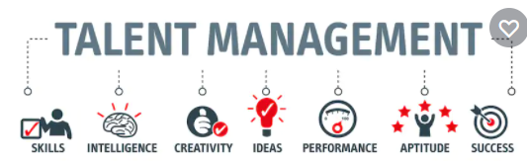
Talent Management
Talent management is organization focus towards complete management of recruitment, retention, development of brightest talent available. The focus of talent management is to attract best talent in the market and convert them into efficient and effective work force. Talent management team is responsible for hiring, maintaining and retaining the best talent.

Slide 50
Components of Talent Management Program
Number of talented people hired
Training of these talented people
Job performance
Retention
Succession planning
Compensation management
Performance management

Slide 51
Talent management softwares
SAP’s Success Factors- A SaaS company is a company that hosts an application and makes it available to customers over the internet. SaaS stands for Software as a Service. This infers that the software sits on a SaaS company's server while the user accesses it remotely.
Core competency: web based performance management
https://www.zdnet.com/article/saas-checklist-nine-factors-to-consider-when-selecting-a-vendor/

Slide 52
Talent management softwares
Taleo’s -
Core Competency: Recruitment of new employees
https://www.youtube.com/watch?v=Ov9nxBiJzXQ - Taleo Applicant System
https://www.youtube.com/watch?v=k-ixNBFfJAU - What can Taleo do for your recruitment process
https://www.youtube.com/watch?v=KKlrh64Fllw - Taleo Recruitment Cycle Introduction
https://www.youtube.com/watch?v=cPaxy-TtPmo - Taleo Training1

Slide 53
Talent management softwares
Cornerstone, OnDemand and Saba
Core competency: Learning and development
https://www.cornerstoneondemand.com/ - Smart for business and great for people

Slide 54
Quiz
Which of the following is not one of the "four pillars" of talent management systems?
Performance management
Business intelligence (BI)
Recruitment
Learning tools
Notes:
Ans B

